Slide 1
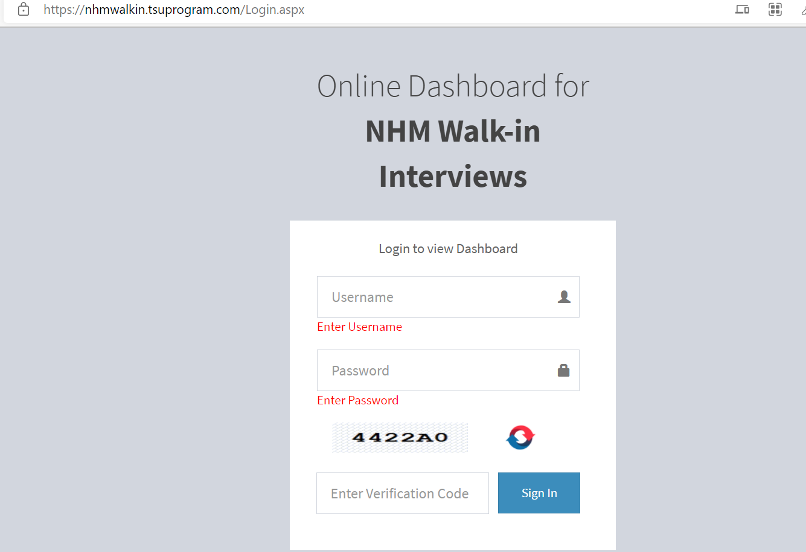
Application user manual
Link: https://nhmwalkin.tsuprogram.com/Login.aspx
Type Username
Type Password
For date wise report click here
For overall report click here
Type Captcha

Slide 2
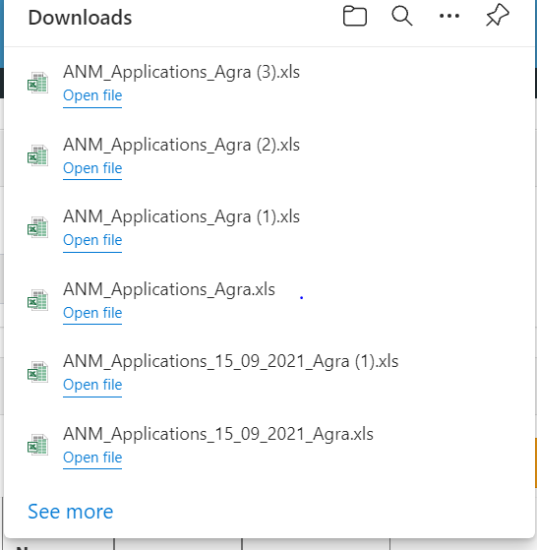
Application user manual
For report in excel click here and “save as the sheet from “text (tab delimited) to “excel work book”.
Click on “Export to excel” to download report

Slide 3
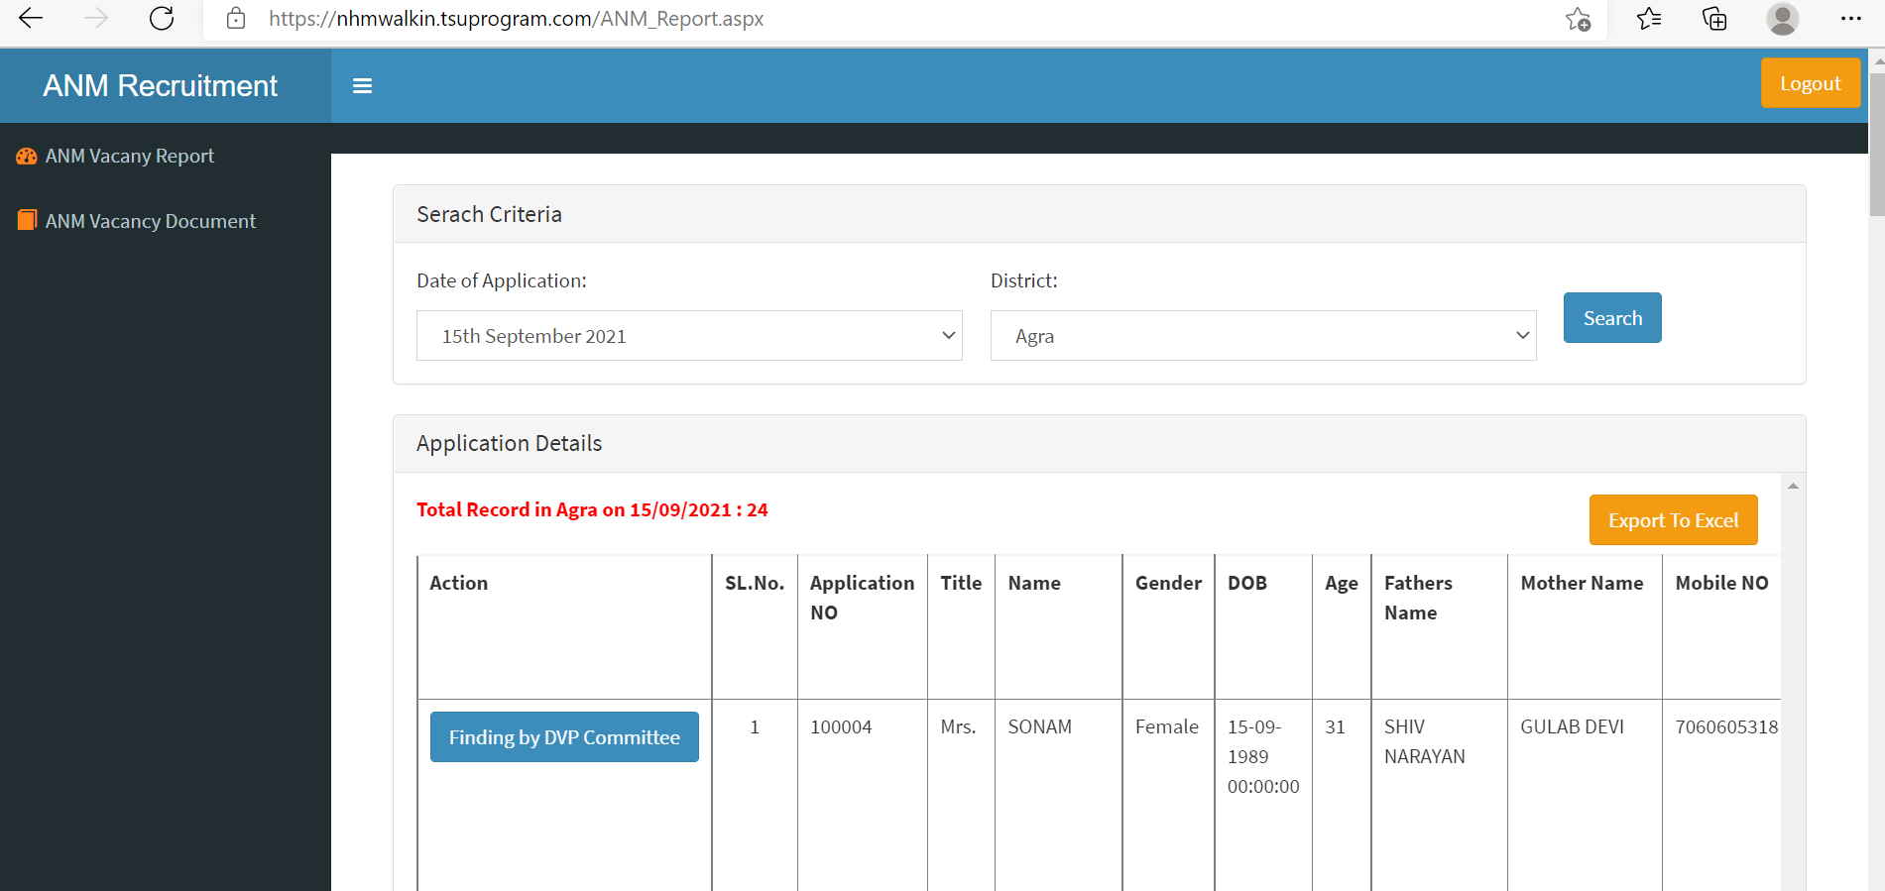
Application user manual
Click here to initiate DVP process

Slide 4
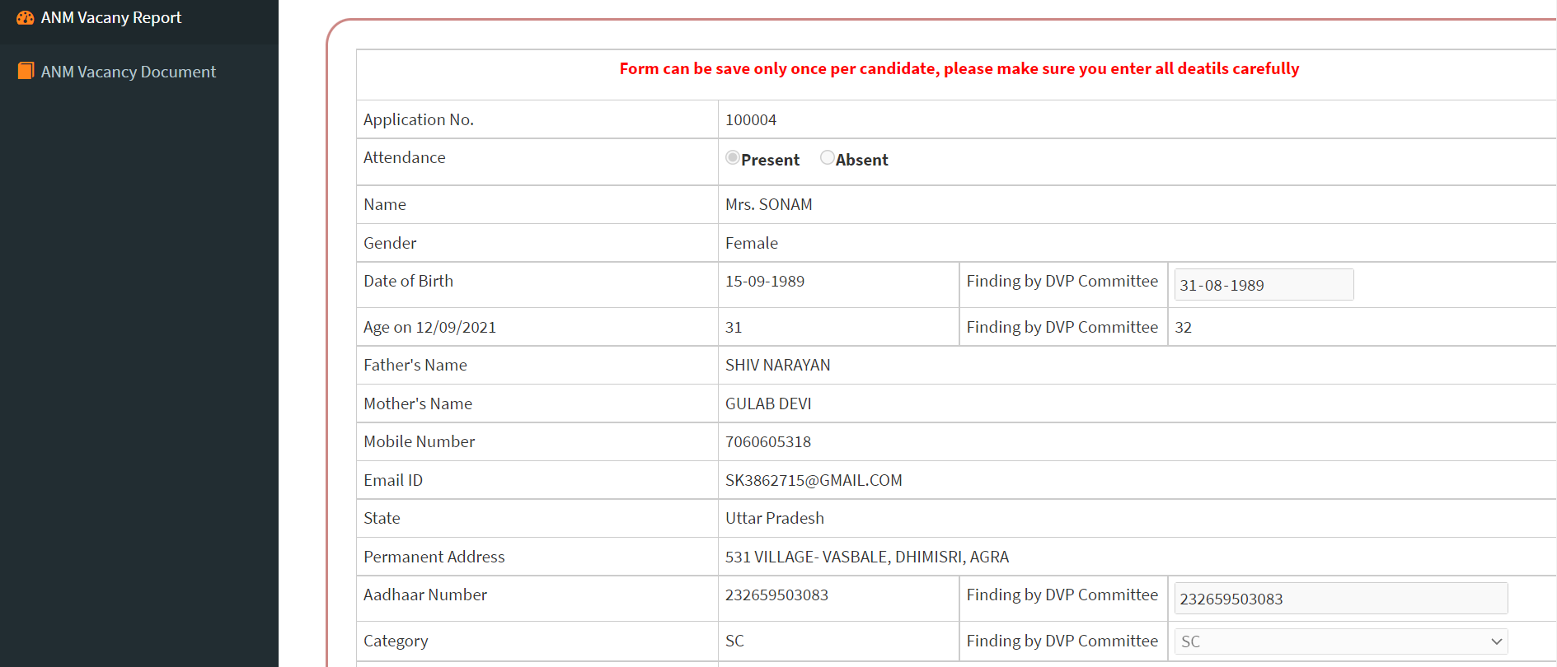
Application user manual
Mark attendance and check all details
Verify DOB
Verify Aadhaar

Slide 5
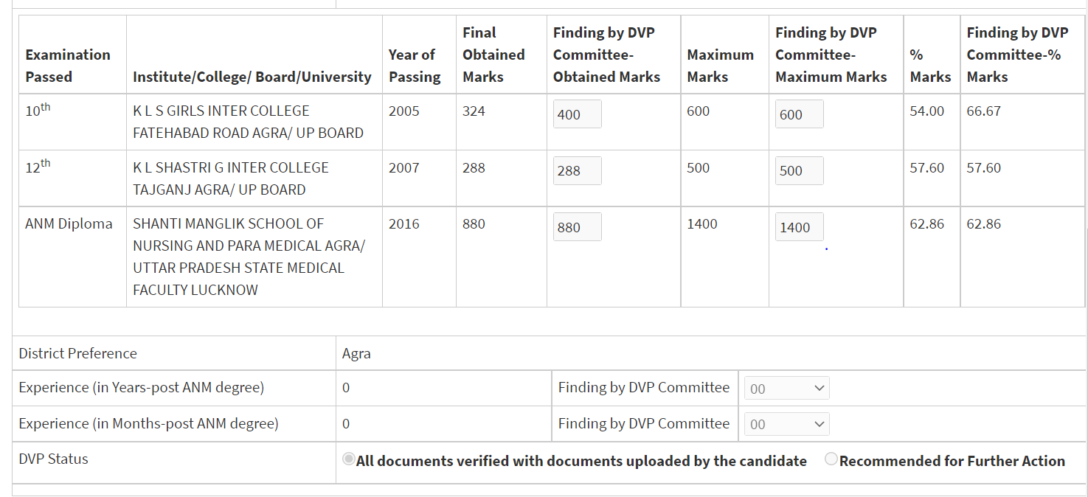
Application user manual
Verify education qualification with uploaded documents by candidate
Verify experience
Note: Valid experience post ANM degree and registered with UP State council

Slide 6
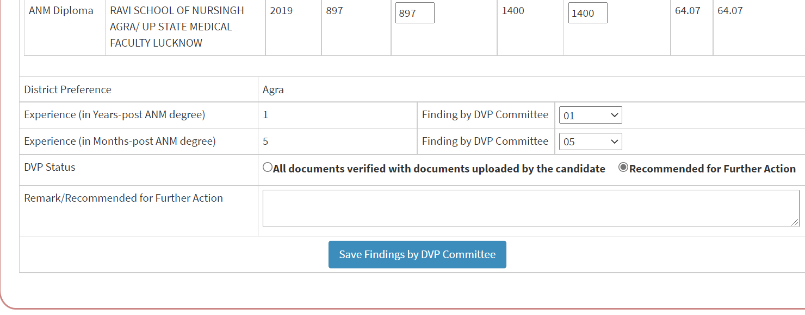
Application user manual
C
Click here once all document verified
If required further action click here and put remarks for further action.
Provide remarks why further action is required
Click here and save finding by DVP committee
Note: one submission only allowed

